Slide 1
DMSMS and Parts Management
“Synergy – The bonus that is achieved when things work together harmoniously” ~Mark Twain
August 3, 2022
Robin Brown
Parts and DMSMS Management Program Manager
R&E Engineering Systems & Architecture
Defense Standardization Program Office (DSPO)
Defense Microelectronics Cross Functional Team (DMCFT)
Robin.Brown@dla.mil
DISTRIBUTION STATEMENT A. Approved for Public Release

Slide 2

Challenges We Face Today
Rapidly changing technology and accelerated acquisition timelines
Service life extensions
Increased use of commercial parts
Offshore manufacturing
Lack of visibility into our supply chain
Obsolescence / DMSMS
Counterfeit parts
Use of lead-free electronic parts and other
environmental considerations
Plus, many more!
Parts Selection is Key!
DISTRIBUTION STATEMENT A. Approved for Public Release
Notes:
2

Slide 3
DoD Instruction 4245.15
Diminishing Manufacturing Sources and Material Shortages
(DMSMS) Management
Establish and implement risk-based, proactive DMSMS management throughout the life cycle of all DoD items
Evaluate all DoD system designs and redesigns for potential DMSMS cases that could arise during the life cycle of a DoD item
Implement resolutions if necessary to mitigate or minimize negative impacts from risks of DMSMS throughout the life cycle management of DoD items
Implement improvements to DMSMS management processes throughout the life cycle of all DoD items across the DoD enterprise
DISTRIBUTION STATEMENT A. Approved for Public Release

Slide 4
OSD Responsibilities
USD(A&S)
  Establish DMSMS management policy, guidance, and training
  Mitigate DMSMS risk throughout the life cycle
ASD(A)
  Integrate risk-based, proactive DMSMS management processes in policy, guidance, and training
  Address DMSMS impacts over the life cycle
  Standardize DMSMS contract language
  Designate Working Group member
  Support ASD(S) in monitoring
ASD(S)
  Serve as the DOD principal for DMSMS
  Establish Working Group and appoint a co-chair
  Integrate DMSMS management into policy, guidance, and training
  Monitor overall effectiveness and efficiency
DCMA
  Integrate DMSMS management into policy, guidance, and training
  Surveil contractor's DMSMS activities
  Communicate risk to DoD customers
  Designate Working Group member
DASD(IP)
  Integrate DMSMS management into policy, guidance, and training
  Communicate industrial base DMSMS issues to DoD Components and assist in resolutions
  Support ASD(S) in monitoring
  Establish Priority Allocation of Industrial Resources Task Force to address issues
  Designate Working Group member
USD(R&E)
  Integrate DMSMS management into policy, guidance, and training
  Support ASD(S) in monitoring
  Provide technical assistance to Components
  Designate a Working Group co-chair
  Define DMSMS GIDEP requirements
DISTRIBUTION STATEMENT A. Approved for Public Release

Slide 5
Components & Program Office Requirements
Component Heads:
Establish DMSMS management policy, guidance, and training
Designate a lead office
Designate Working Group member
Confirm adequacy of risk evaluation in technical reviews
Establish metrics and internal reporting requirements
Share cases with GIDEP
Direct supply organizations to identify and communicate issues and risks
Direct acquisition organizations to follow procedures
Coordinate with other organizations to address risk
Program Offices:
Develop and Update DMSMS Management Plan
Maintain Data
Evaluate Designs for DMSMS
Mitigate Risks
Program and Budget for Operations and Resolutions
Include Provisions in Contracts for Reporting, Technical Data, Exit Strategy
Resolve Issues in a Timely Manner
Communicate with Supply Organizations to Mitigate Risk
Train their Workforce
Evaluate Activities during Logistics Assessments and Technical Reviews
DISTRIBUTION STATEMENT A. Approved for Public Release

Slide 6
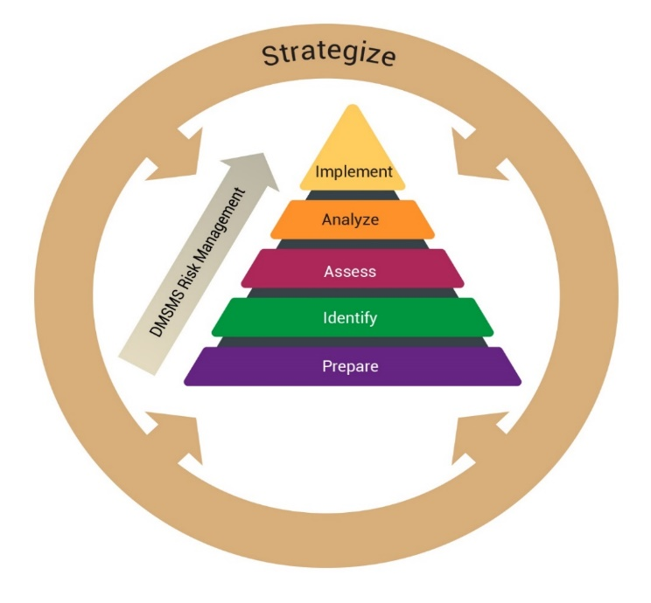
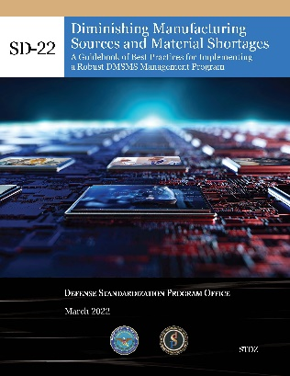
DoDM 4245.15 Establishes Procedures
Section 1: General Issuance Information
1.1. Applicability.
Section 2: Responsibilities
2.1. Under Secretary of Defense for Acquisition and Sustainment (USD(A&S)).
2.2. Assistant Secretary of Defense for Sustainment (ASD(S)).
2.3. Assistant Secretary of Defense for Acquisition.
2.4. Under Secretary of Defense for Research and Engineering (USD(R&E)).
2.5. DoD Chief Information Officer.
2.6. DoD Component Heads.
Section 3: Procedures
3.1. DMSMS Management Process.
3.3. Identify DMSMS Issues.
3.4. Assess Need, Timing, and Level of a DMSMS Resolution.
3.5. Analyze Resolution Options.
3.6. Implement Resolution Options.
Appendix 3A: DMSMS Management Record Keeping
Section 4: DoD DMSMS Working Group Charter
4.1. Purpose and Scope.
4.2. Membership.
4.3. Functions.
Glossary
Prepare: DMSMS Management Program Infrastructure
Identify: DMSMS Monitoring and Surveillance
Assess: Resolution Need, Timing, and Level
Analyze: DMSMS Resolution Determination
Implement: Implementation of DMSMS Resolutions
SD-22 DoD DMSMS Guidebook
GUIDANCE
BEST PRACTICES!!
DISTRIBUTION STATEMENT A. Approved for Public Release

Slide 7
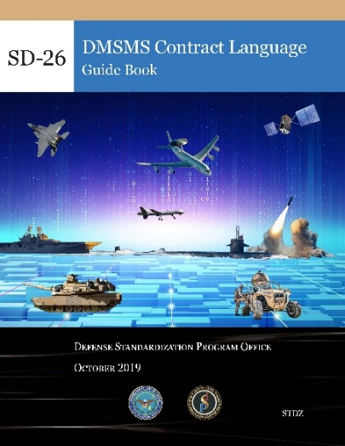
SD-26, IEC-62402, and SAE-STD-0016
DISTRIBUTION STATEMENT A. Approved for Public Release

Slide 8
Why do Proactive DMSMS Management?
DMSMS Forecasting and Resolution -
  Increases the likelihood of implementing a lower cost resolution / More time to consider all applicable options
  Minimizes DMSMS-related out-of-cycle redesigns
  Eliminate DMSMS-related schedule impacts
  Increases operational availability
  Reduces or controls total ownership cost
PROACTIVE
Program discovers that an item will be obsolete as of date X (no longer available for purchase)
Long window of opportunity to address DMSMS issue before the program is impacted; all or most resolution types available (i.e., lower cost)
Program will be impacted by DMSMS
Timeline
Date X
REACTIVE
Item becomes obsolete, without the program knowing
The program discovers that the item can no longer be purchased
Timeline
Date X
Brief window of opportunity to address DMSMS issue before the program is impacted; limited resolution types available (likely higher cost)
CAN WE DO BETTER THAN THIS!?
DISTRIBUTION STATEMENT A. Approved for Public Release

Slide 9
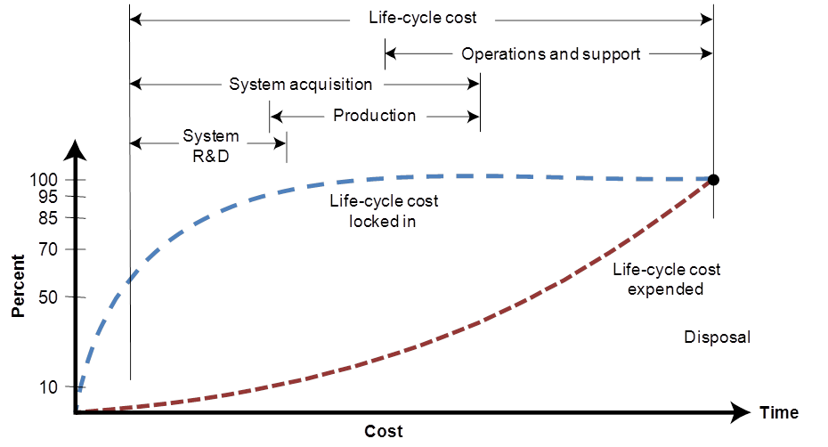
We Can Do Better - Let’s Build DMSMS-Resilient Designs!
Early design decisions substantially impact operations and support costs (sustainment)
DMSMS is one product support design tradeoff consideration
So, why not create DMSMS-resilient designs (and apply future system modification / refresh planning) to avoid DMSMS issues altogether in addition to delaying the occurrence of DMSMS issues that can not be prevented?
DMSMS resilience is achieved by selecting long life cycle items, avoiding single sources of supply, using open architecture in designs, and other techniques
Source: W.J. Larson and L.K. Pranke, Human Spaceflight: Mission Analysis and Design (McGraw-Hill, 1999).
DISTRIBUTION STATEMENT A. Approved for Public Release

Slide 10
DoD Parts Management Program
Parts Management Policy
  DoDI 5000.88, Section 3.6.f Parts Management.
  “The PM will ensure that a parts management process is used for the selection of parts during design to consider the life cycle application stresses, standardization, technology (e.g., new and ageing), reliability, maintainability, supportability, life cycle cost, and diminishing manufacturing sources and material shortages. As applicable, parts management requirements should be specified in the RFP’s statement of work for the TMRR, EMD, and production acquisition phases.”
  DoDI 5000.88, Section 3.7.f. Standardization.
  “The PM will plan for the identification and implementation of specifications and standards that support interoperable, reliable, technologically superior, and affordable capabilities pursuant to DoDI 4120.24.”
  DoDM 4120.24-M, Section 3.2.4, Parts Management.
  "Program offices shall ensure that a parts management process is used to reduce the proliferation of parts and associated documentation and promote the use of parts with acceptable performance, quality, and reliability."
Better Parts Selection
Reduced Costs
Enhanced Readiness and Interoperability
Reduced Acquisition Lead-Time
Increased Supportability and Safety
Enhanced Reliability and Maintainability
Reduce Logistics Footprint

Slide 11
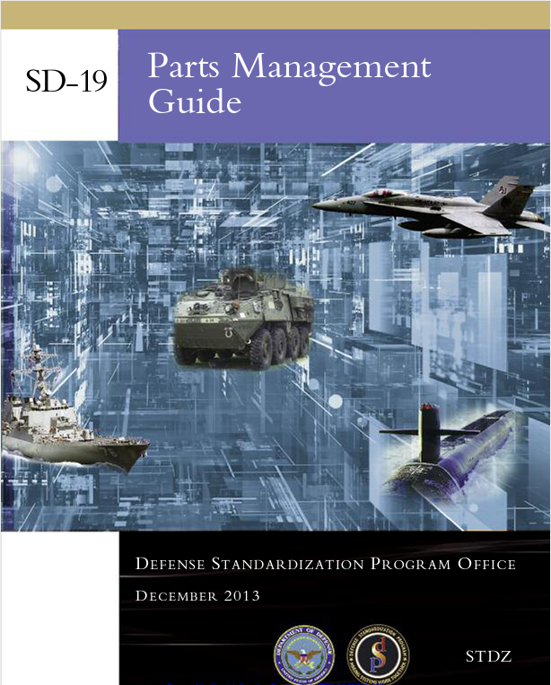
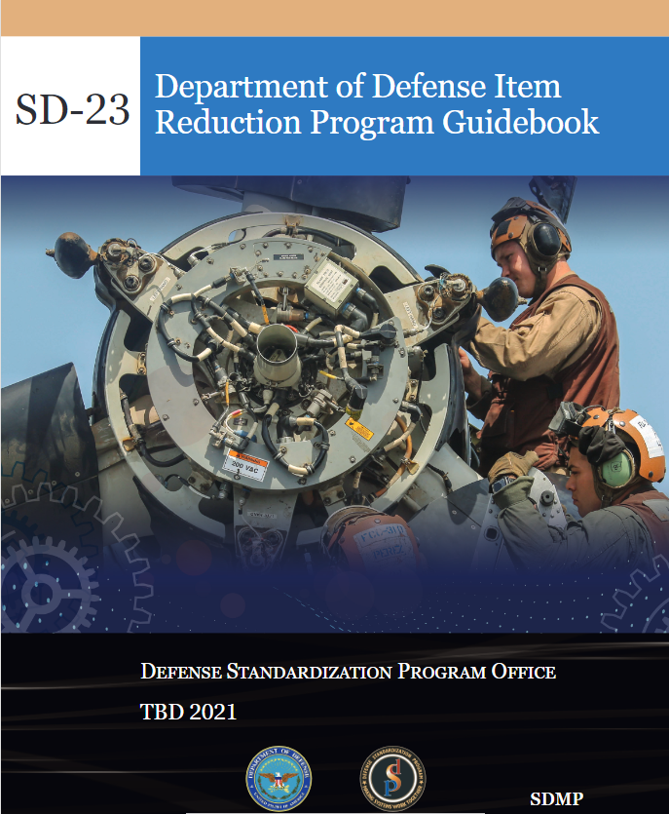

Parts Management Guidance
DISTRIBUTION STATEMENT A. Approved for Public Release

Slide 12
Other Policy, Guidance, Legislation , Etc.
Policy-Related Reviews | Guidance-Related Reviews | Legislation-Related Reviews | Drafting/Comment Adjudication
DoDI 8330.01 | DAG Chapter 3 | Strategic Competition Act | DoDM 4245.15
DoDI 5000.UQ | DAG Chapter 5 | FY 22 NDAA | SD-19
Anti-Tamper Directive | Engineering of Defense Systems Guide | EO 14017 Report | SD-22
Counterfeit DoDI | Systems Engineering Guidebook | China legislation | SD-23
Digital Engineering DoDI | ITRA guidance | S4272 | MIL-STD 3018
DoDI 5200.XX | SAE 15026 | DMSMS DFARS Clause | New parts management instruction
DoDM 5200.XX | SAE 0016 | LON Buy legislative proposal | DoDI 4245.15
DoDM 4140.01 V10 | PSM Guidebook | IP legislative proposal | SD-26
DoDM 4140.01 V2 | M&Q guidebook | EO 13806
DoDM 4140.01 V3 | Systems Engineering Plan Guide | Section 845 report
DoDM 4140.01 V9 | Life Cycle Sustainment Plan Outline | Section 809 report
DoDI 5000.02 | PPP Outline and Guidance | Industrial Base report to Congress
DoDD 5000.01 | Technology and Program Protection Guidebook | Rad Hard report to Congress
DoDM 4140.26 | Guide to DoD Program Management Business Processes | Industrial Capabilities report
DoD 7000.14-R | MRL Users Guide
DoDI 3110.05 | MRL Criteria Matrix
DoDI 5200.44 | Guide for Integrating SE into DoD Acquisition Contracts
Additive Manufacturing DTM | JIBWG Battery Strategy
Logistics DTM
DoDI 5000.83
DoDI 4140.67
DISTRIBUTION STATEMENT A. Approved for Public Release

Slide 13
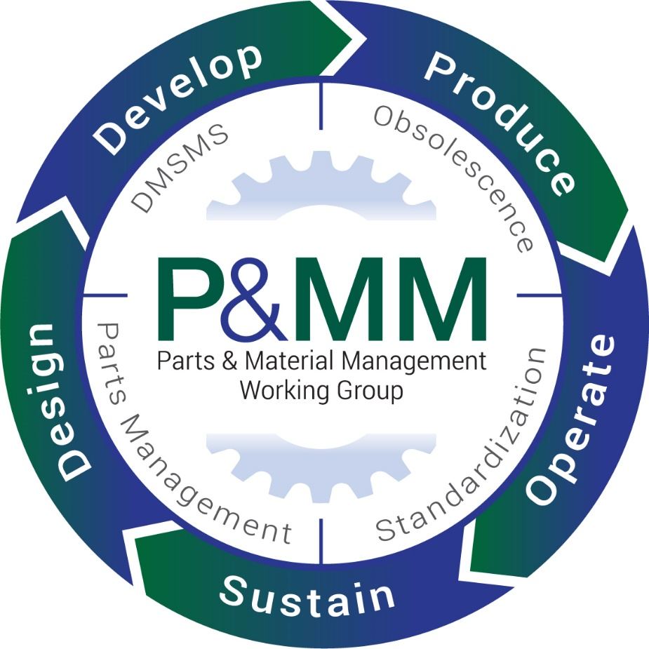
Parts & Material Management Working Group
DMSMS Management
Create and revise DoD DMSMS policy, guidance, and management strategies.
Champion proactive DMSMS management best practices, synergies, and standardization through education, training, and outreach in DoD and industry.
Define and assess DMSMS management effectiveness across DoD.
Establish and pursue DoD-wide strategic DMSMS objectives.
Prepare and publish guidance documents.
Facilitate common, collaborative resolutions to crosscutting DMSMS issues.
Parts Management
Review and revise DoD parts management policy and guidance;
Assess the effectiveness of DoD parts management activities across;
Research, find, and promote parts management best practices across DoD and industry;
Prepare and publish SD-19, “Parts Management Guide;”
Prepare and publish Military Standard (MIL-STD) 3018, “Parts Management;”
Promote parts management education and engagement; and
Establish and pursue DoD-wide parts management strategic objectives.
DISTRIBUTION STATEMENT A. Approved for Public Release

Slide 14
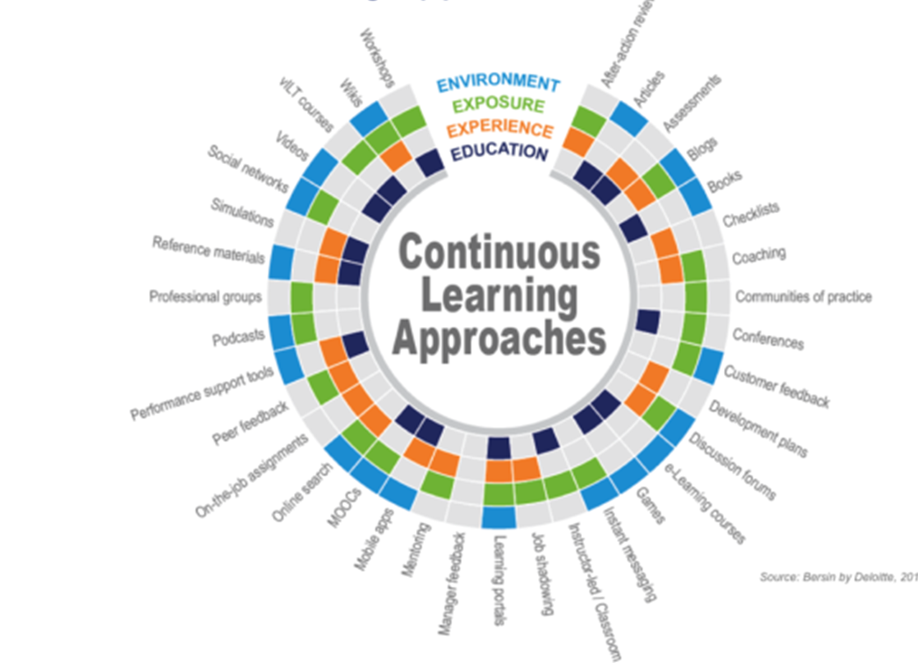
Growth Mindset – Continuous Learning
Defense Acquisition University (DAU) CLCL Parts and Material Life-Cycle Management Credential
  Deployed February 14, 2022
  You may register for DAU training at https://www.dau.edu/training/p/apply-for-a-course and access online training course materials
Credential brings together 13 On-line Training Courses and supporting Resources to offer a comprehensive overview of DoD Parts and Material Life-cycle Management
  CLL 032 Preventing Counterfeit Parts in DoD Supply Chains (1 hour)
  CLL 038 Provisioning & Cataloging (7 hours)
  CLL 047 Sustaining Engineering (2 hours)
  CLL 051 System Retirement, Disposition, Reclamation, Demil, Disposal (2 hours)
  LOG 0640 DMSMS: What Program Managers Needs to Know (2 hours)
  LOG 0650 DMSMS Fundamentals (6 hours)
  LOG 0660 DMSMS Executive Overview (1 hour)
  LOG 0630 Introduction to Parts Management (1 hour)
  LOG 0670 DMSMS Component Research (1 hour)
  LOG 0390 Additive Manufacturing (Planned FY21 Development) (Est 3 hours)
  CLC 004 Market Research (3 hours)
  CLE 019 Modular Open Systems Approach (3 hours)
  CLE 026 Trade Studies (2 hours)
~34 Hours
DISTRIBUTION STATEMENT A. Approved for Public Release

Slide 15
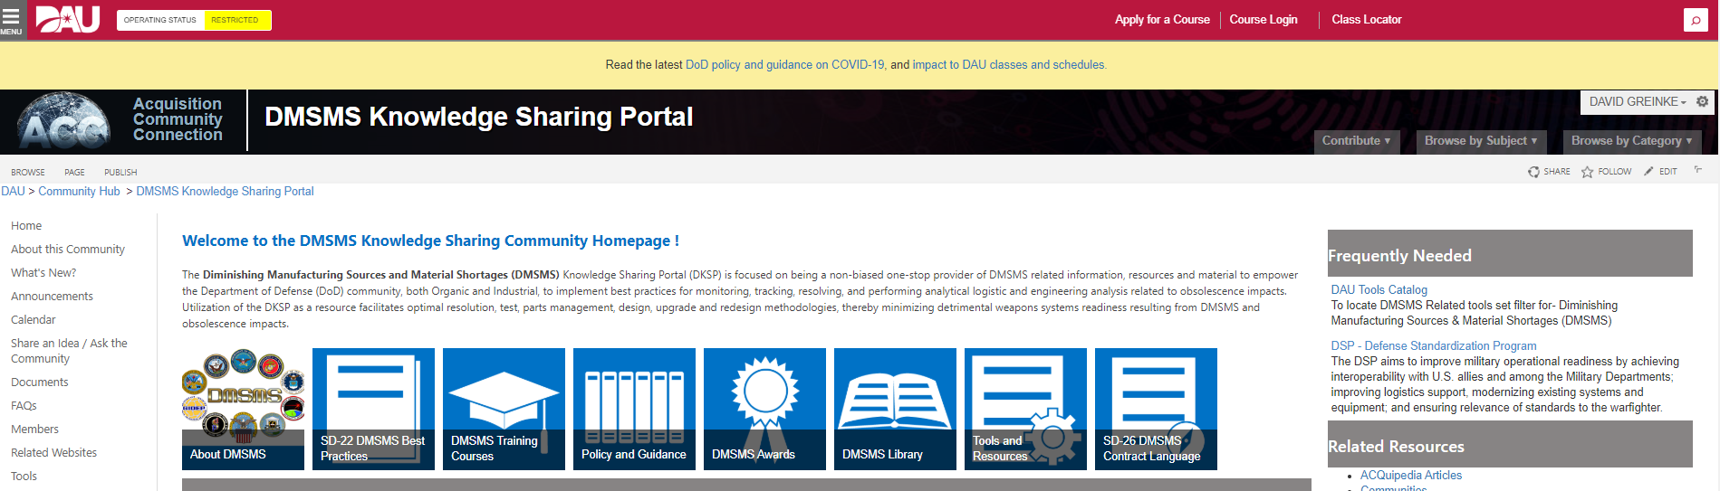
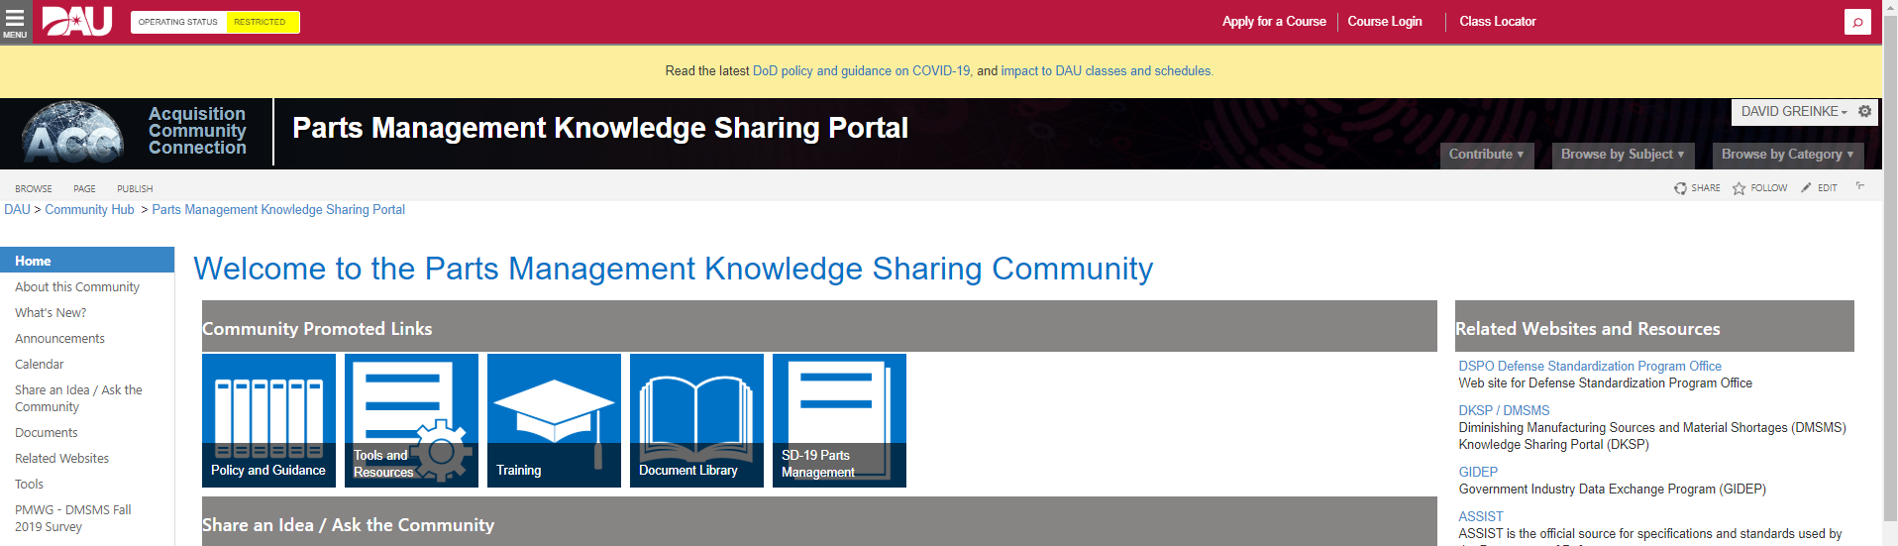
DAU Knowledge Sharing Portals
DMSMS Knowledge Sharing Portal (DKSP): https://www.dau.edu/cop/dmsms/
Parts Management Knowledge Sharing Portal (PMKSP): https://www.dau.edu/cop/pmksp/

Slide 16

Strengthen Your Network
Parts & Material Management Conference (PMMC2023)
  When: February 6-9, 2023
  Where: Savannah, Georgia
  Theme: Ensuring Sustainable Systems through DMSMS and Parts Management Excellence
  More Information: www.pmmcmeeting.org/2023/
2022 DMSMS Achievement Awards
  Nominations due November 1, 2022
  Winners notified January 6, 2023
Other Working Groups
  Joint Industrial Base Working Group (JIBWG)
  Supply Chain Resilience Working Group (SCRWG)
  Supply Chain Risk Management Working Group (SCRMWG)
  Joint Defense Manufacturing Council (JDMC)
  Commercial ME Assurance Framework Working Group
  Service and Industry Working Groups
  International Institute Obsolescence Management (IIOM)
  Defense Microelectronics Cross Functional Team (DMCFT)
DISTRIBUTION STATEMENT A. Approved for Public Release

Slide 17
DMCFT Vision Statement:
Guaranteed, long-term Access to Measurably Secure Microelectronics enabling
Overmatch Performance and increasing Military Operational Availability and Warfighter Combat Readiness
Defense Microelectronics
Cross Functional Team (DMCFT)
Ensure timely access to measurably secure and affordable ME technology
Motivate programs and their primes to modernize and exploit the most capable ME
Leverage tools, policies and enforcement to reduce or eliminate costly sustainment issues
Centralize knowledge in a DoD "front door" organization to augment decentralized execution
Increase ME discovery and innovation, and accelerate transition into DoD systems
Contribute to and influence interagency and national efforts to grow ME capabilities to meet national security needs
Cultivate a right-sized workforce with the right skills at the right place and the right time
17
DISTRIBUTION STATEMENT A. Approved for Public Release
Notes:
17

Slide 18
DMCFT - Need for Action from the Parts & DMSMS Management Communities
Program Lifecycle
Program Development
PPP/CPI
Design
Verify
Mask
Fabrication
Package & Test
Verify & Validate
Config./Prog. SW
Integrate & Test
Operation & Maint.
Modify and Develop Policy, Guidance, and Training
  Conducting standard parts and DMSMS management processes;
  Mitigating associated cybersecurity risks as a function of the specific application;
  Developing and using metrics to monitor activities and to help measure and improve efficiency and effectiveness;
  Promulgating best practices by updating the standardization-related documents;
  Establishing and using contract language that will articulate government needs in an understandable and executable way
Enterprise Parts Management System (EPMS) will:
  Improve mission effectiveness and readiness by strengthening supply chains, enabling better parts selection, and reducing the use of tampered or counterfeit parts.
  Enable the design of DMSMS resilient systems and reduce the impact of DMSMS on DoD systems and will reduce expensive redesigns and one-time buys.
  Enable the DoD to improve availability of parts and improve US government investments in domestic manufacturing by enabling the ability to forecast current and future demand (both in-production and obsolete parts).
  Reduce procurement costs because DoD by enabling aggregate purchases and employing commonality to increase efficiencies and buying power.
  Aid programs in determining the optimal timing for modernization.
DISTRIBUTION STATEMENT A. Approved for Public Release

Slide 19

DISTRIBUTION STATEMENT A. Approved for Public Release

